Slide 1

AMAZON E-Commerce

Slide 2
Agenda
Problem Statement
Key Metrics
Total Sales by Product Category
Unique Customers by Year
Total Sales by Product
Average of Wait times by Delivery Type
Revenue Distribution
Monthly Sales: Current Year vs Previous Year
Reports

Slide 3
Problem Statement
You are working as a business analyst at Amazon, a company currently performing well. The stakeholders wish to maintain this level of performance and seek improvement. For this purpose, they want to devise new strategies.
You are part of a team exploring new ways to benefit customers, such as offering more discounts and Prime membership perks. Could you suggest additional methods to identify and reward customers and enhance their shopping experience?

Slide 4
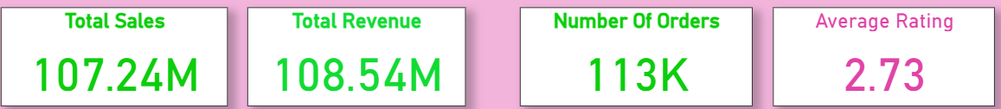
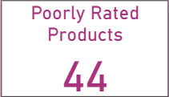
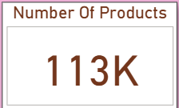
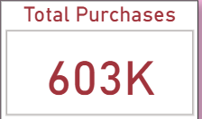
Key Metrics

Slide 5
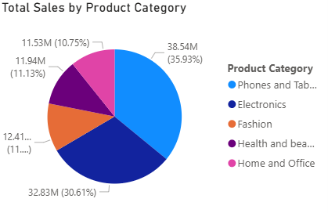
Total Sales by Product Category
Phones and Tablets hold the largest share of total sales, contributing 38.54M (35.93%).
Electronics come second with 32.83M (30.61%) of the total sales.
Fashion accounts for 12.41M (11.57%), showing a moderate share.
Health and Beauty contributes 11.94M (11.13%).
Home and Office has the smallest share at 11.53M (10.75%).

Slide 6
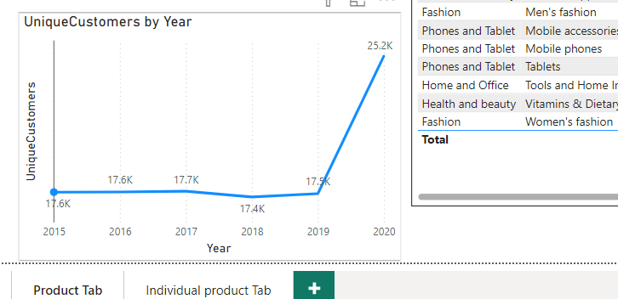
Unique Customers by Year
From 2015 to 2019, the number of unique customers showed relative stability, ranging between 17.4K and 17.7K.
In 2020, there was a significant increase in unique customers, reaching 25.2K

Slide 7
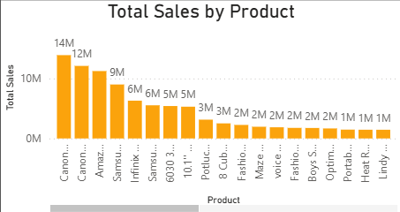
Total Sales by Product
Canon EOS 600D and Canon EOS 60D DSLR cameras are the highest-selling products, indicating high demand for quality photography equipment.
The Amazon Fire HD 8 Kids Tablet and Samsung Galaxy A02 smartphone show strong sales, that reflects customer interest in family-friendly and affordable devices.
Products with sales amounts closer to 1M or 2M may be more focused but still have potential for growth. These products can be used as tailoring marketing strategies or expanding the product line which helps to increase their visibility and sales.

Slide 8
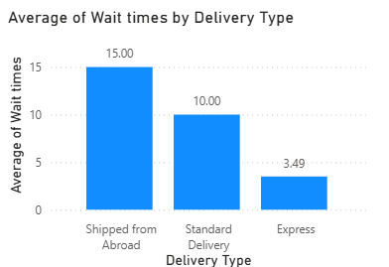
Average of Wait times by Delivery Type
Average wait times are correlated with the delivery type chosen when ordering a product.
Significant variations in wait times exist based on the delivery method:
"Shipped from Abroad" has the longest average delivery time (15.0).
"Express Delivery" offers the shortest average delivery time (3.5).

Slide 9
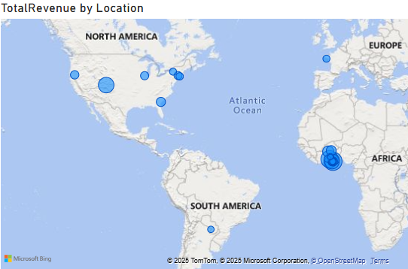
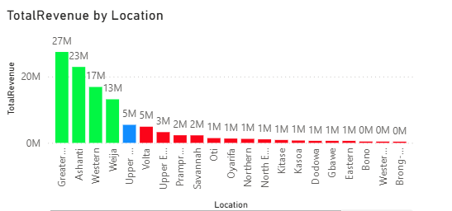
Revenue Distribution
Greater Accra, Ashanti and Western regions have high demand for products, making a key for marketing and business expansion.
Prampram, Savannah, or North East, there are opportunities to increase market share by tailoring strategies to local demands and promoting products more effectively.
Amasaman, Bono East and Dawhenya regions have lower sales, indicating smaller populations or be less commercially developed compared to higher-performing regions.

Slide 10
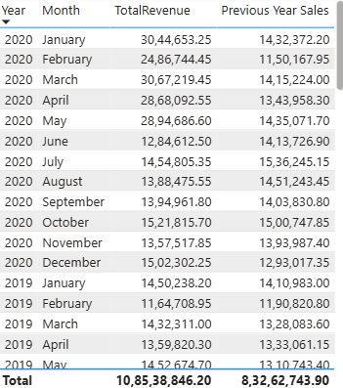
Monthly Sales: Current Year vs Previous Year
Early 2020 Sales Growth: January 2020 showed strong revenue (₹30.45L) compared to the previous year.
February Dip: February 2020 had lower sales (₹24.87L), suggesting promotion opportunities.
Strong Months: May 2020 (₹28.95L) and October 2020 (₹15.22L) showed high performance.
Higher Sales in March & July: March 2020 (₹30.67L) and July 2020 (₹14.55L) had stronger sales, possibly due to promotions

Slide 11
Recommendations
Market Segmentation Analysis: Leverage customer demographic data (age, gender, location) to segment the market and implement targeted marketing strategies tailored to specific customer groups and regions.
Minimize Waiting Time: Enhance customer satisfaction by reducing delivery wait times, especially for products shipped internationally.
Performance Monitoring: Conduct regular evaluations of delivery metrics such as delivery speed, accuracy, and customer feedback to identify areas for operational improvement.
Customer Loyalty Program Development: Create a personalized loyalty program based on customer purchase frequency, behavior, and spending, offering rewards, incentives, and exclusive benefits to boost customer retention.
Promotional Strategy Enhancement: Analyze sales patterns to identify seasonal trends, high-demand periods, and low-performing months, optimizing marketing campaigns to maximize sales during key timeframes.

Slide 12
Reports

Slide 13
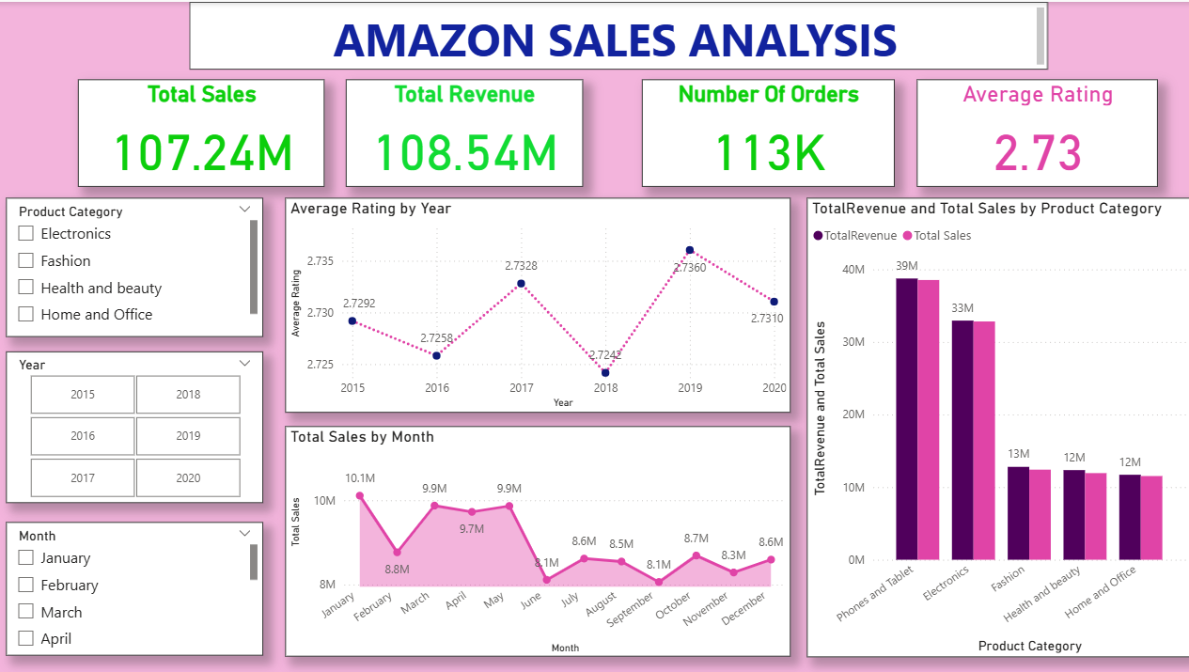

Slide 14
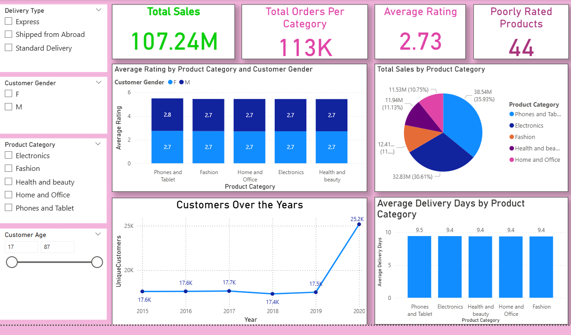
Product Category Analysis

Slide 15
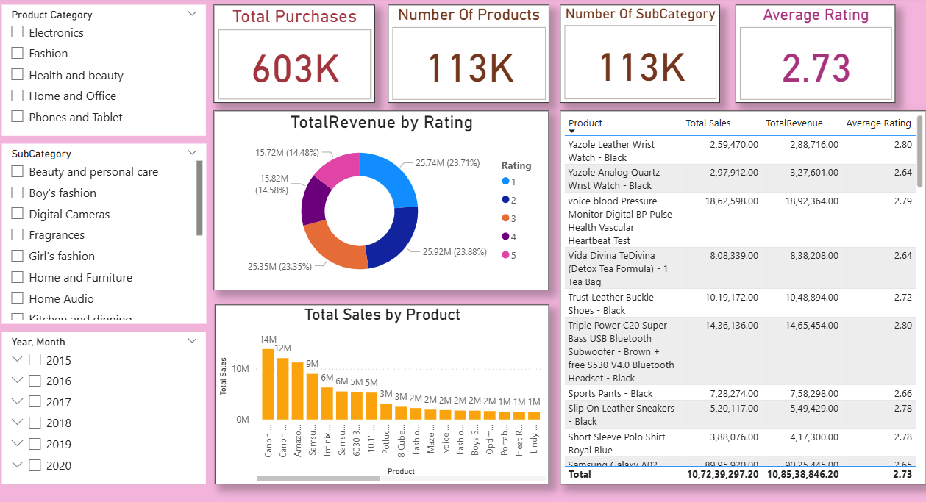

Slide 16
Thank You

